Slide 1

TESTING USING
SELENIUM
AND
TESTNG

Slide 2
UNIT : PERFROMANCE TESTING
SUKHMANDEEP SINGH
201418

Slide 3
ABOUT PROJECT
WEB PAGE
USING HTML, CSS
SELENIUM
TESTNG
TESTING WEB PAGE WITH SELENIUM
PARALLEL TESTING
ORGANIZING CODE

Slide 4

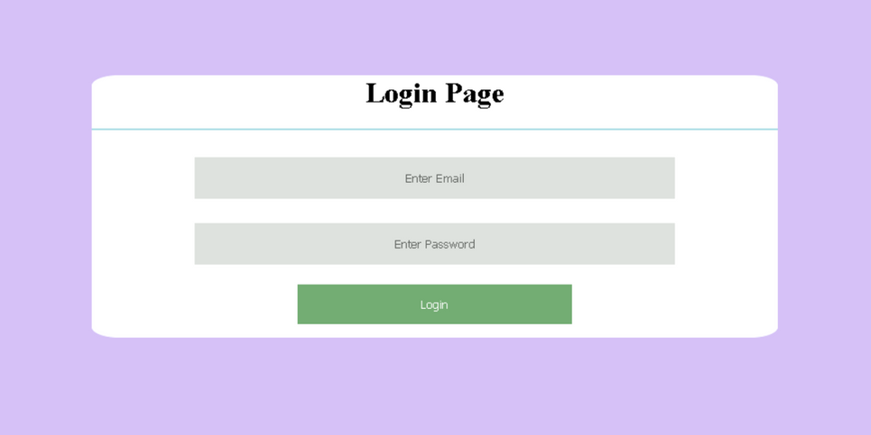

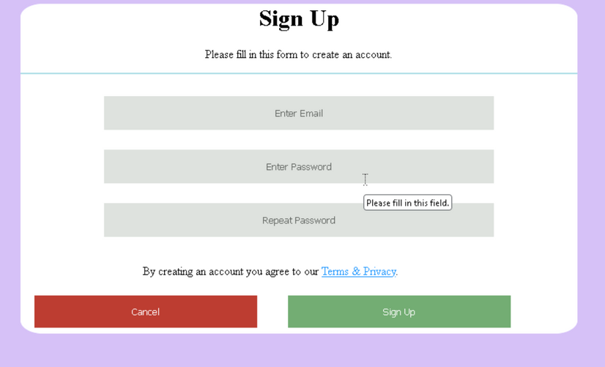
WEB PAGES

Slide 5

1.
Automation Tool
2.
Cross-browser Testing
SELENIUM
Programming Language Support
3.
4.
Open Source

Slide 6
1.
Testing Framework
2.
Annotations
TestNg
3.
Parallel Test Execution
4.
Test Suite Configuration

Slide 7

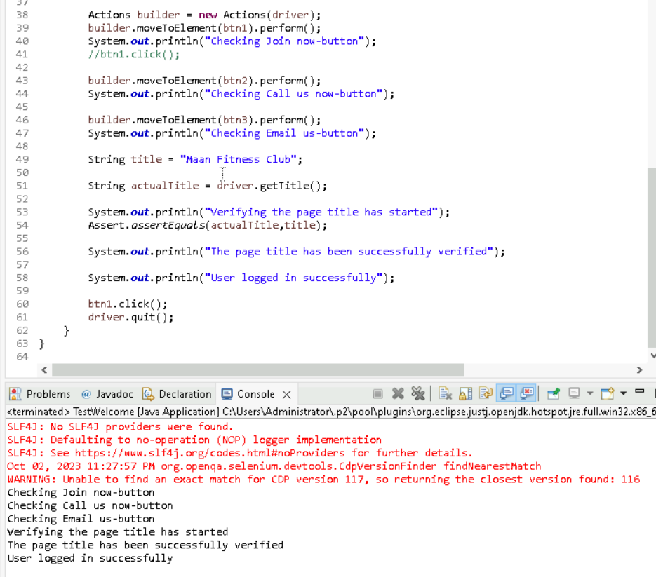
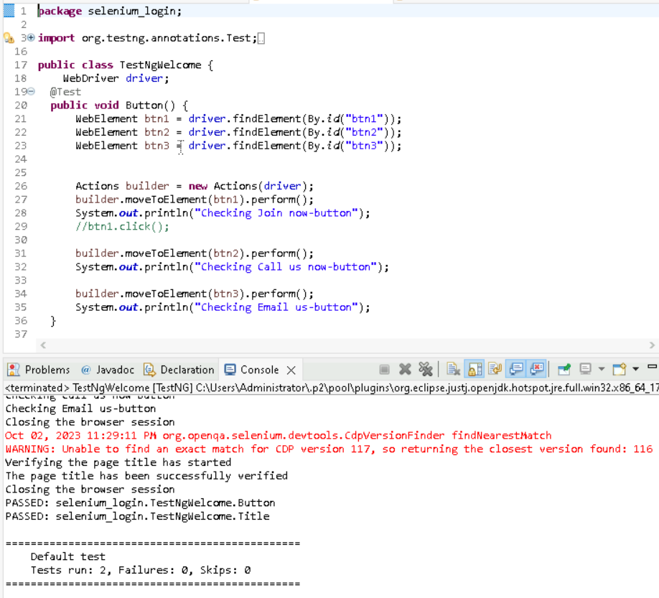
HOME PAGE TESTING

Slide 8
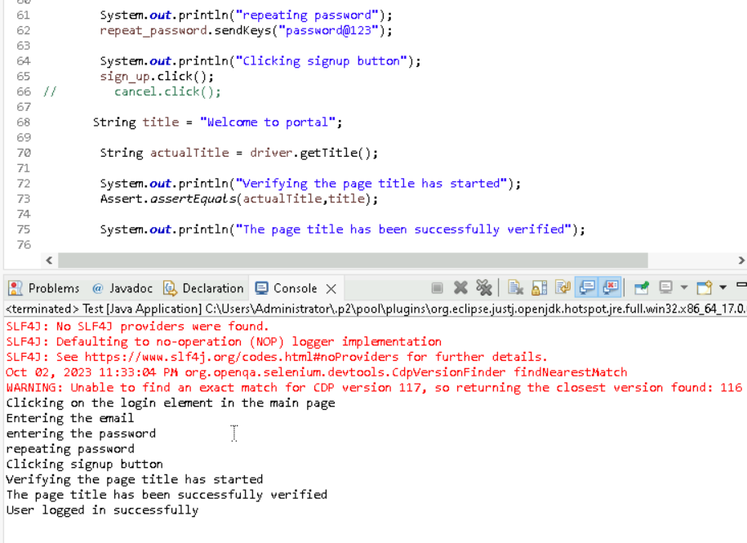
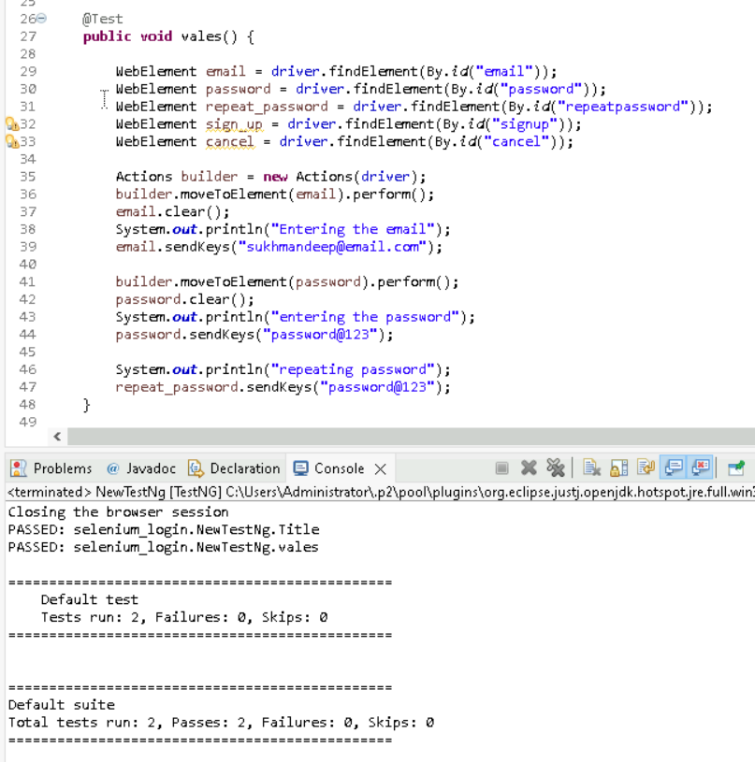
SIGN UP PAGE TESTING

Slide 9
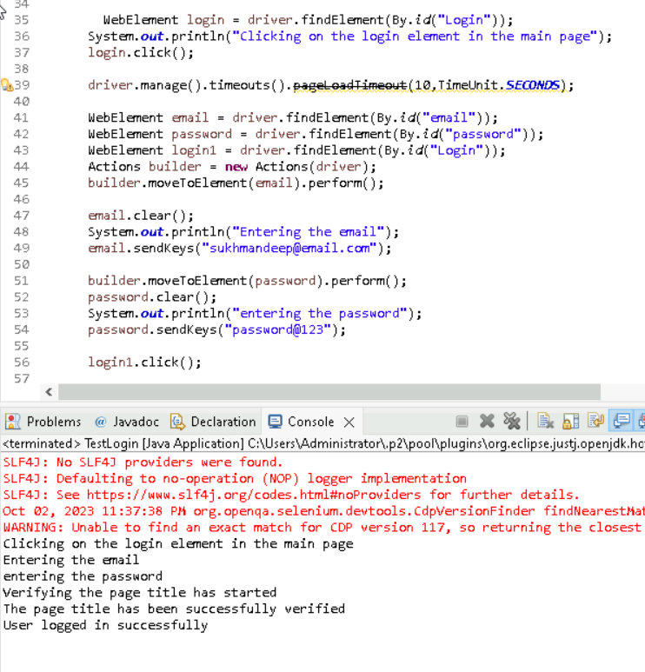
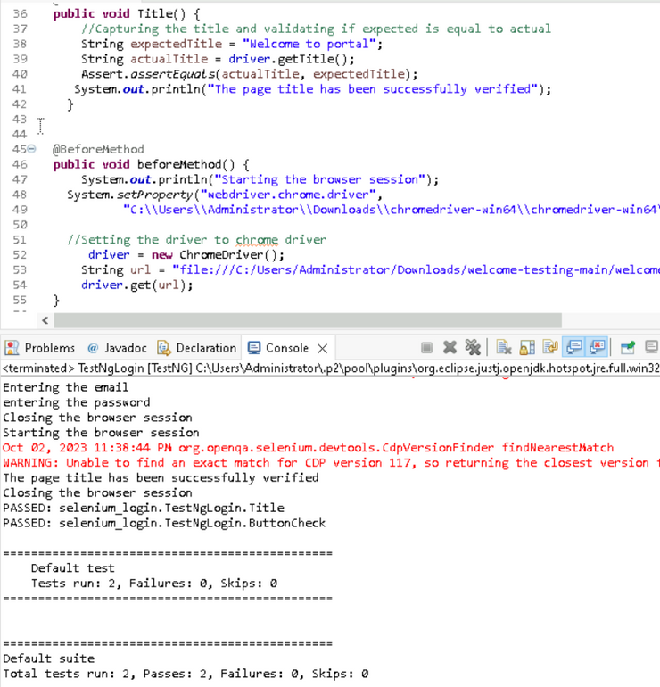
LOGIN PAGE TESTING

Slide 10

THANK YOU

